Slide 1
Experian Fraud Detection
Abraham Owodunni (ML Eng)

Slide 2


Introduction
Business Problem
Importance/Impact
Challenges
Solution
Approach
Key Component
Notes:
Business Problem: Fraud Detection in Financial Transactions
Importance: Fraud poses significant financial risks and impacts trust in financial systems.
Challenges: Detecting fraudulent activities amidst large volumes of legitimate transactions.
Impact: Losses to consumers, businesses, and financial institutions; erosion of trust and reputation.
Solution: Leveraging Machine Learning for Effective Fraud Detection
Approach: Implementing advanced machine learning techniques to enhance fraud detection capabilities.
Key Components:
Real-time Monitoring: Continuous surveillance to swiftly identify suspicious transactions.
Predictive Analytics: Algorithms to predict and prevent potential fraud before it occurs.

Slide 3







Business Problem
Impact
Complexity
Consumers
Financial Institutions
Evolving Techniques
Imbalance Data
Businesses
Notes:
Impact on Stakeholders:
Consumers: Fraud can lead to financial losses, identity theft, and compromised personal information.
Businesses: Merchants suffer from chargebacks, lost inventory, and damage to reputation due to fraudulent transactions.
Financial Institutions: Face financial losses, regulatory scrutiny, and erosion of customer trust.
Complexity of Fraud: Financial institutions face intricate challenges in detecting various types of fraudulent activities and because humans are behind it the problem evolves. Also we have an issue with imbalance data.

Slide 4









Solution
POV
Technology
Trust
Comfort
Seamless Integration
Machine Learning
Monitoring
Approach
Notes:
Customer Perspective
Customer-Centric Focus: Balancing high recall for fraud detection with high precision to minimize disruptions.
Trust and Security: Ensuring transactions are secure with high recall in fraud detection.
Minimal Disruption: Maintaining customer satisfaction by minimizing false alarms.
Approach to Fraud Detection
Machine Learning Framework: Utilizing machine learning for real-time fraud detection.
Real-time Monitoring: Promptly flagging suspicious transactions using predictive analytics.
Technology Integration
Optimized Models: Selecting models based on speed, interpretability, and performance metrics.
Seamless Integration: Integrating fraud detection into existing systems for enhanced operational efficiency.

Slide 5


Slide 6
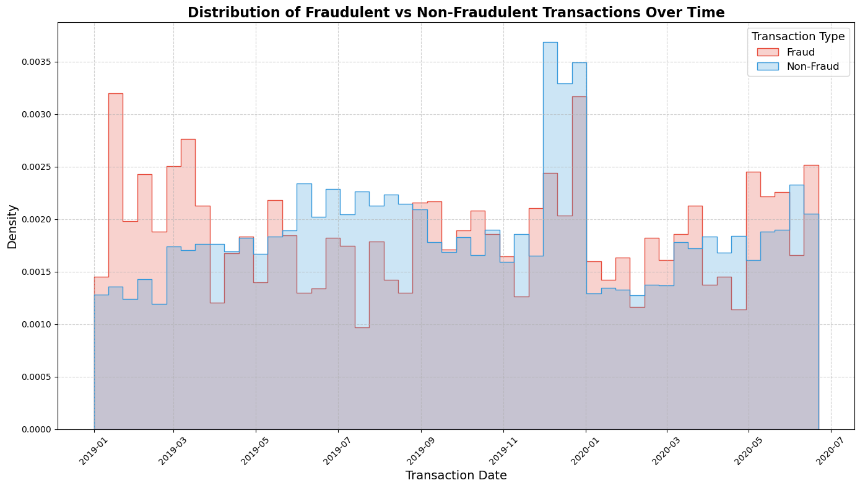
Distribution of Transaction (Fraud vs Non-Fraud)
Notes:
- The fraudulent activities show a variation over time. So we need to keep in mind that season might not have an effect on fraudulent activities.**
- We still have peaks for fraud transactions but in the grand skim of things its leaning on the variation side. Early in the year and end of year.

Slide 7
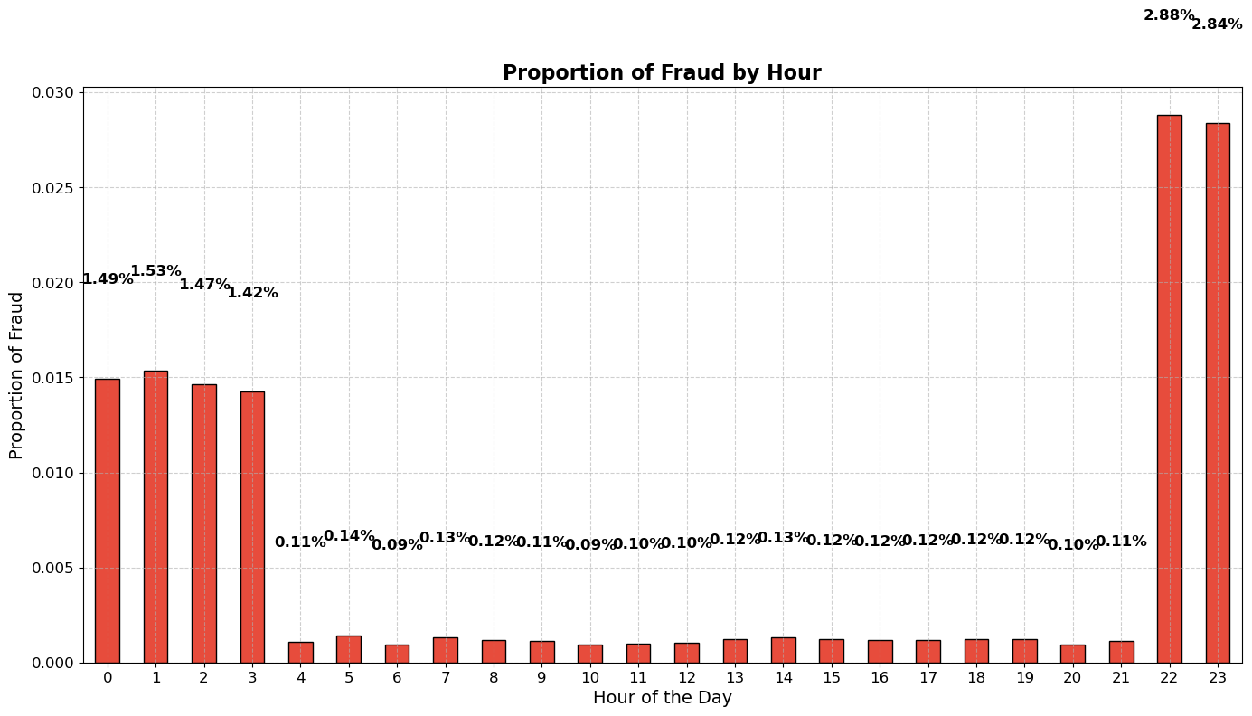
Fraud by Hour
Notes:
- If we dive deeper, most if the fraudulent transactions are typically done all day but at Night time between 10 pm - 3 am we have an increase.
- Can this be due to the fact that the victim might be in bed?.
- It is clear that hour of the day plays a big part in fraudulent transactions.

Slide 8
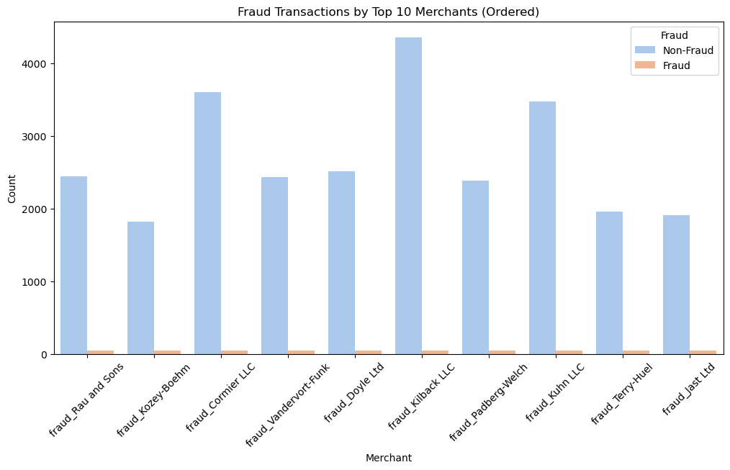
Top 10 Merchants
Notes:
This is synthetic data.

Slide 9
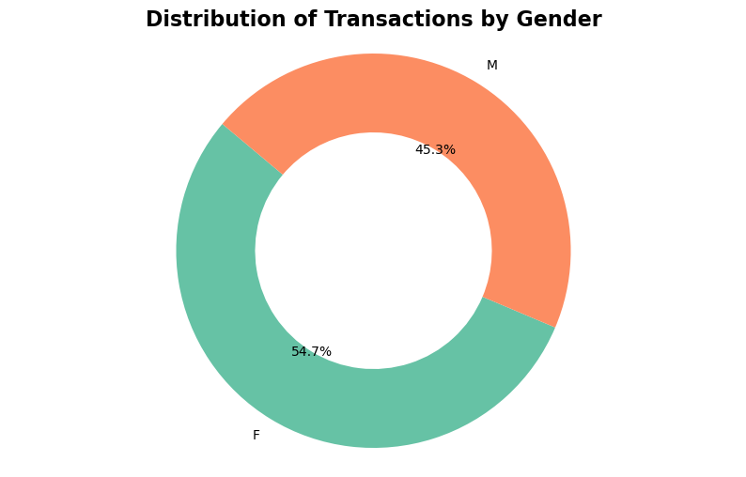
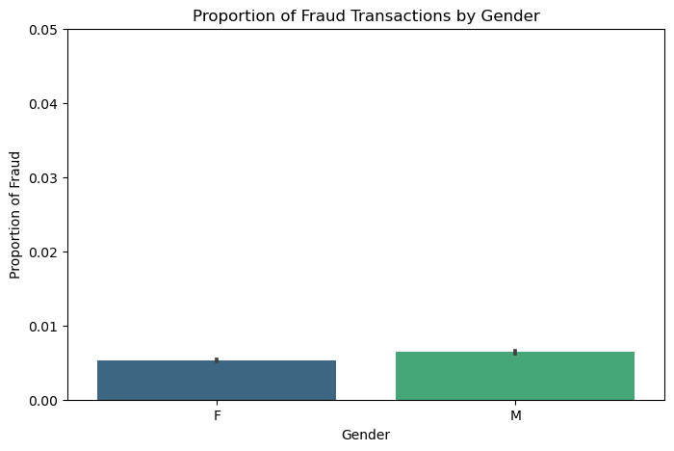
Distribution of Transaction (Male vs Female)
Notes:
Men have been affected the most.

Slide 10
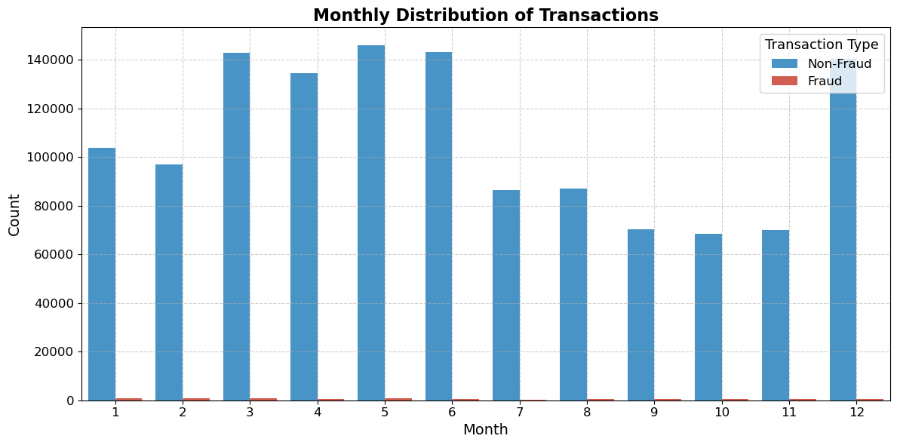
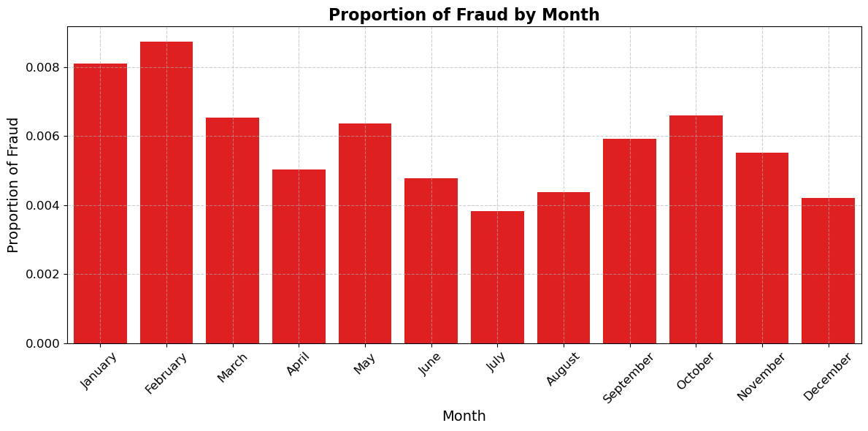
Distribution of Transaction (Monthly)
Notes:
February, January, and October are months with relatively higher fraud proportions.
Understanding these patterns can help in developing targeted fraud detection strategies for specific times of the year.

Slide 11



Data Processing

Slide 12

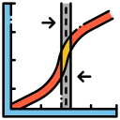







Model Research
Objective
Linear
Gradient Boosting
Metrics
Considerations
Classifiers
Accurate
F1 (recall & precision)
AUC-ROC
Speed
Model interpretability
Computational efficiency
Tree-Based
Clustering
Notes:
Initial Model Evaluation
Linear Models:
Logistic Regression
Tree-Based Models:
Decision Tree
Random Forest
Gradient Boosting Machines:
XGBoost
CatBoost
AdaBoost
Nearest Neighbor:
K-Nearest Neighbors (k-NN)
Support Vector Machines (SVM)
Approach
Objective: Select the most suitable classifier for fraud detection.
Evaluation Criteria: Metrics include accuracy, F1 score, and AUC-ROC.
Considerations: Model interpretability, computational efficiency, and suitability for real-time fraud detection.

Slide 13


Model Selection
Model | Precision | Recall | F1 | Speed (seconds)
Logistic Regression | 0.18 | 0.73 | 0.29 | 9.4
Decision Tree | 0.72 | 0.74 | 0.73 | 99.5
Random Forest | 0.94 | 0.69 | 0.80 | 1838.8
XGBClassifier | 0.92 | 0.77 | 0.84 | 8.2
CatBoost | 0.91 | 0.76 | 0.83 | 448.8
XGBClassifier
Notes:
Selected Models for Testing
Logistic Regression: Less complex, initial baseline.
Decision Tree: Interpretable but prone to overfitting
Random Forest (RF), XGBoost, CatBoost: Boosting methods for enhanced performance.
Refined Selection:Focused Approach: Prioritize recall with a balanced F1 score
Final Choice: XGBoost (XGBClassifier) emerged as optimal after initial testing.

Slide 14





Model Tuning
Challenges
Parameters
Computational Limitations
CPU
GPU
Approach
Trial and Error
Learning Rate
N_estimation
Max Depth
Notes:
Challenges Faced
GridSearch Limitations:
GPU Constraints: Insufficient GPU power for GridSearch.
Google Colab Issues: Timing out during computation.
Approach to Parameter Tuning
Trial and Error Method:
Adjusted parameters iteratively due to GridSearch limitations.
Parameters Chosen:
Learning Rate: 0.6 for faster convergence.
N_estimators: 400 for adequate model complexity.
Max_depth: 8 for balancing model complexity and overfitting.
Reasoning Behind Parameter Selection
Optimization Goals:
Performance: Aimed for improved F1 score and recall.
Efficiency: Balanced computational cost with model effectiveness.
Empirical Validation: Parameters selected based on observed performance gains during experimentation.

Slide 15




Performance Improvement
Threshold Optimization
F1-Score improved from 0.86 to 0.88
Notes:
Evolution of Model Performance Metrics
Threshold Optimization:
Lowering the threshold from 0.5 to 0.22 improved recall, ensuring more fraudulent transactions were detected.
Reasoning:
Enhanced Detection: Lowering the threshold increased sensitivity to detect fraud (class 1) while maintaining high precision for legitimate transactions (class 0).
Improved F1-Score: This adjustment raised the F1-score from 0.86 to 0.88, balancing recall and precision effectively.
Key Benefits
Increased Sensitivity: Enhanced ability to detect fraud, bolstering security measures.
Maintained Precision: Minimized false positives, ensuring smooth transaction experiences.

Slide 16







Production and Deployment
Data Ingestion
Business Problem
Key point:
This is an iterative process and not linear
Deployment & Monitoring
Data Preprocessing & EDA
Model Research
Notes:
Architecture Overview:
Data Ingestion: Collect transaction and behavior data.
Preprocessing: Feature engineering, scaling, encoding.
Model Deployment: API for real-time and batch processing.
Monitoring: Real-time alerts and dashboards.
Feedback Loop: Continuous model updates with new data.
Integration into Systems:
API Deployment: Real-time fraud detection through RESTful API integration.
Batch Processing: Analyze historical data for trends and reporting.
Streaming Data: Continuous monitoring with tools like Apache Kafka or AWS Kinesis.
This streamlined architecture ensures effective integration into existing systems for fraud detection.

Slide 17



Recommendation
More Data
Techniques
Category of fraud
Payment method used
Average monthly spend
System information
Anomaly detection
Behavioral analysis
Clustering
Notes:
1. Improve with More Data:
Additional Features: Collect more data points such as transaction descriptions, geolocation patterns, and card usage patterns.
Report specific categories of fraud (e.g., lost/stolen card, identity theft, counterfeit cardetc, also why kind of payment method, was is by digital wallets, online transaction, or physical.
Average monthly spending.
If possible the device or system info from the fraudulent person.
Behavioral Data: Include customer behavior data like historical transaction behavior and patterns.
2. Advanced Techniques:
Anomaly Detection: Implement unsupervised learning techniques to identify unusual patterns not captured by supervised models.
Clustering: Use clustering techniques to group similar transactions and detect outliers indicative of fraud.
Ensemble Methods: Combine multiple models to leverage their strengths and mitigate weaknesses.

Slide 18

So When Do I Start ;)

Slide 19


